Slide 1
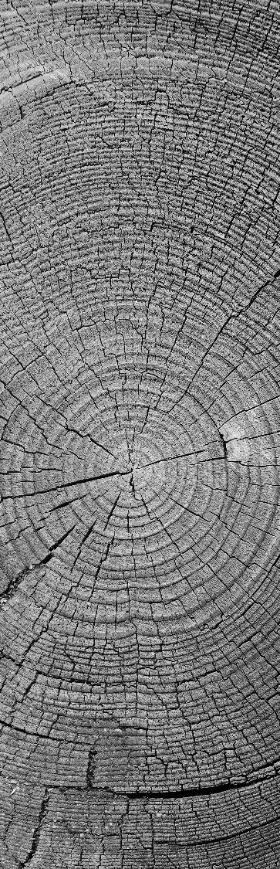
Taxation of Christmas Trees: An In-Depth Look
July 28, 2018
MCTA/Mid-America Summer Meeting

Slide 2

Andrew Bosserman, CPA
Fun Facts
Born and raised in Toledo, OH
Graduated from Miami University with degrees in Accounting and Finance
Certified Public Accountant since 2012
Former IRS agent in Cincinnati, OH
Owned and operated Miami Valley Tree Farm in Cedarville, OH from 2015 - 2018
Attending Wake Forest School of Law in Fall 2018 to become a tax attorney
Author of tax column in Christmas Trees Magazine

Slide 3
Disclaimer
The information presented is for informational purposes only and is not intended to provide specific tax advice. Each individual situation is different and consultation with your own personal tax professional is strongly recommended before acting on any of the information contained in this presentation.

Slide 4
Case Study

Slide 5
Facts - Income
Elroy Evergreen is a Christmas tree grower. The following information pertains to his 2018 operations:
  Tree Income and Costs
    Choose and cut trees are $10/foot. He sells 500 choose and cut trees in 2018. All trees sold are 8 feet tall.
    Potted trees are $30 each. He sells 100 potted trees in 2018.
    He sells $5,000 worth of merchandise in 2018.
    His cost basis per choose and cut tree is $5.
    His cost basis per potted tree is $2.
    His cost of merchandise sold is $2,500

Slide 6
Facts – Other Expenses
Elroy Evergreen is a Christmas tree grower. The following information pertains to his 2018 operations:
  Other Expenses
    He has Car & Truck expenses of $5,000 in 2018.
    He purchases Supplies totaling $2,000 in 2018.
    He purchases $1,000 of Fertilizer in 2018.
    He pays $10,000 for Labor on his farm.
    He purchases new equipment totaling $5,000 in 2018. He has no other depreciation expense from other equipment he owns.

Slide 7
Choose and Cut tree Sales
Internal Revenue Code §631
Value attributable to the current year’s growth is taxed at ordinary rates; all value attributable to prior years growth is taxed at capital gain rates
Fair Market Value of Trees (FMV) @ 01/01/2018 = Capital Gain Income
  Use price trees would have sold for during the 2017 Christmas season
Remaining Income = Ordinary Income
Basis in trees reduces Capital Gain Income

Slide 8
Choose and Cut Sales Calculation

Slide 9
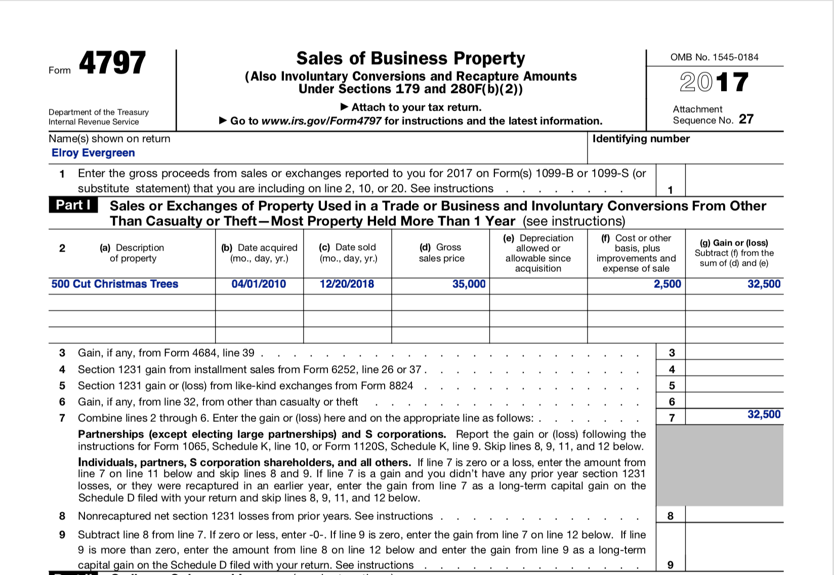
Form 4797

Slide 10
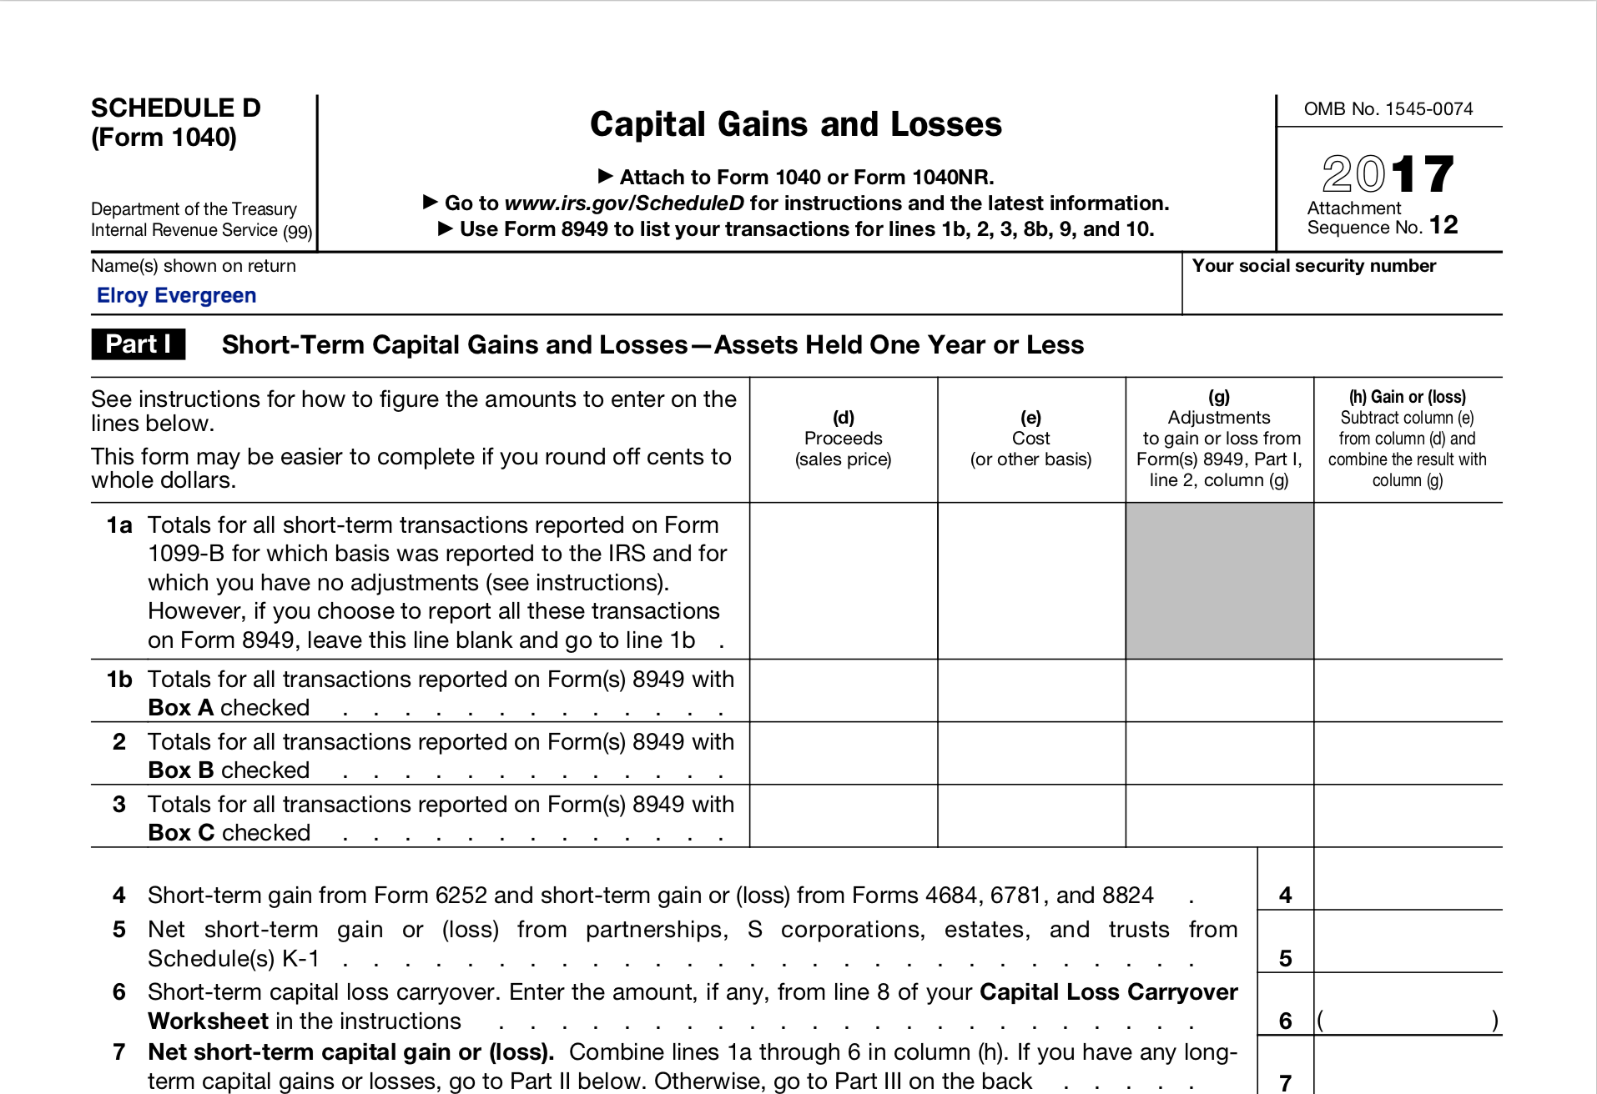
Schedule D

Slide 11
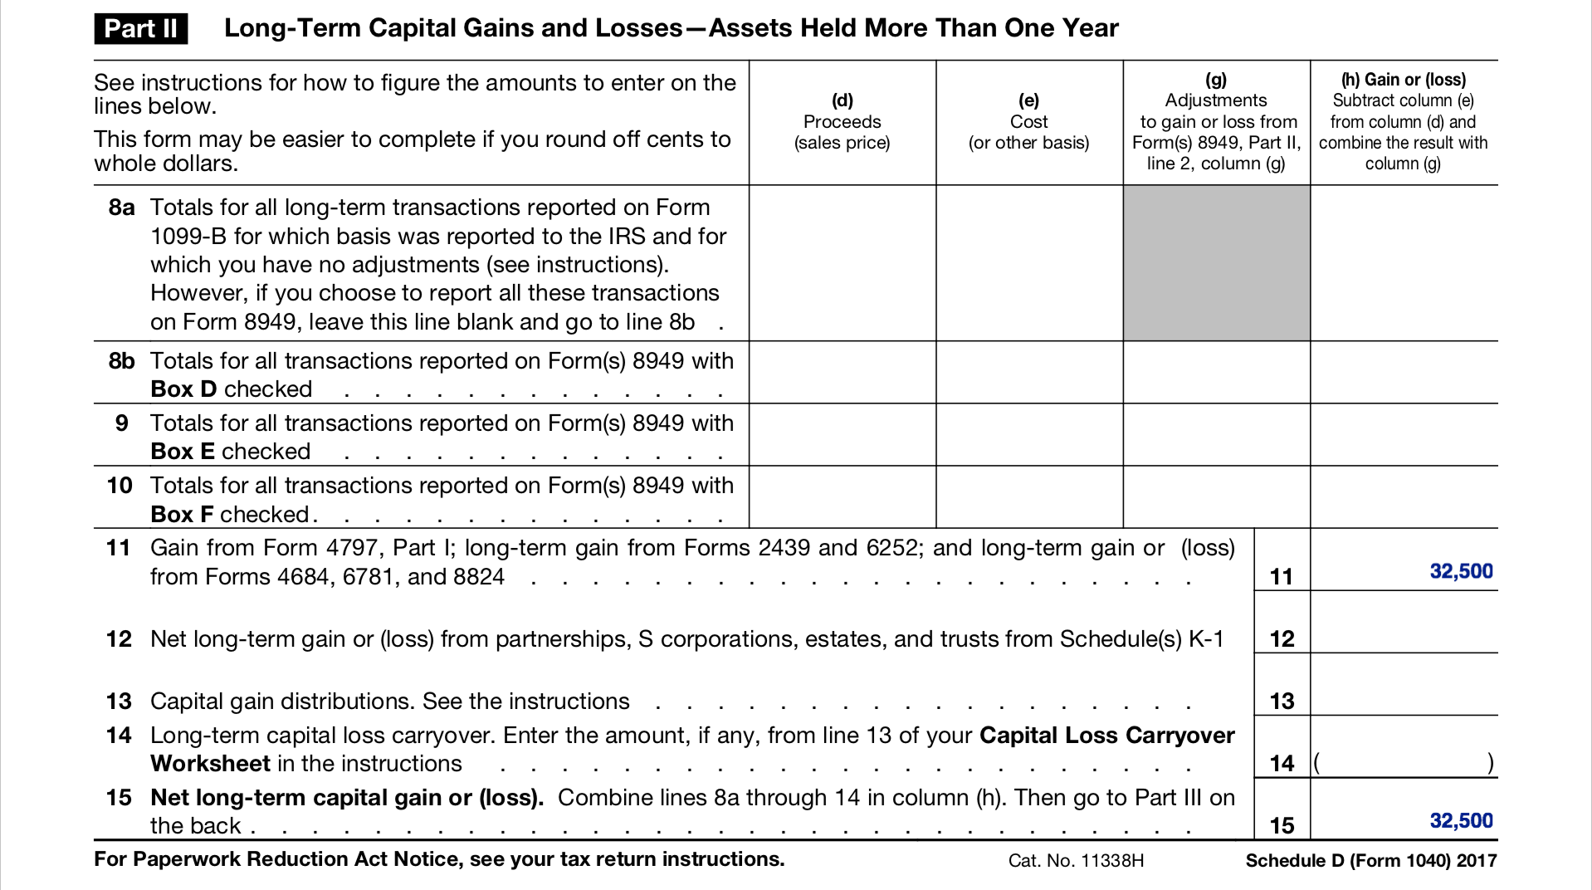
Schedule D - Continued

Slide 12
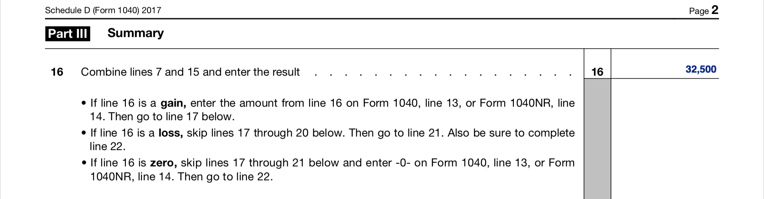
Schedule D - Continued

Slide 13
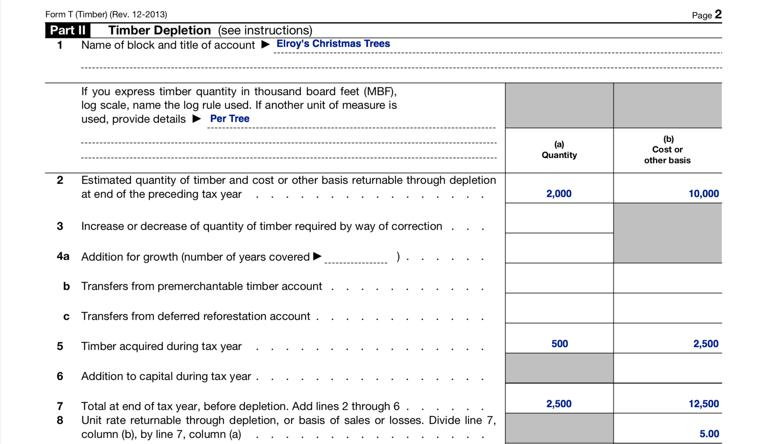
Form T

Slide 14
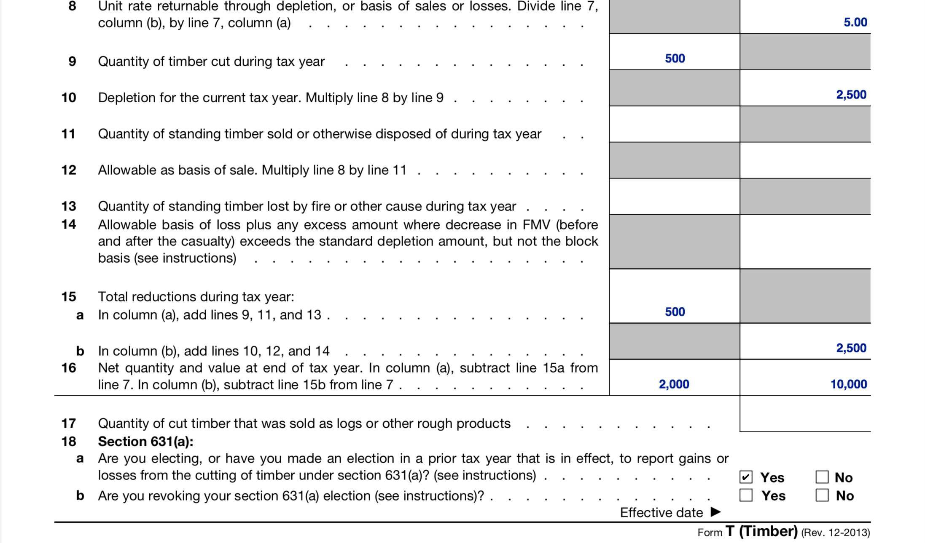
Form T - Continued

Slide 15
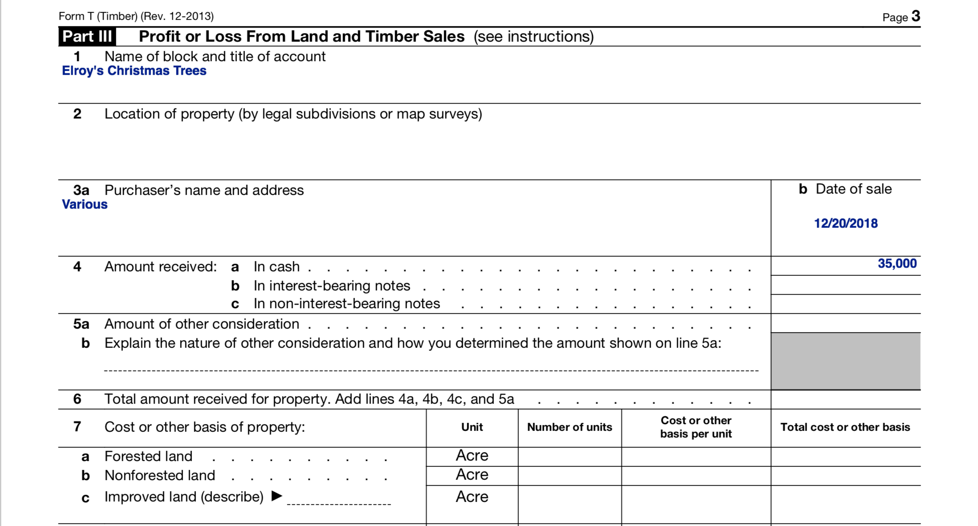
Form T - Continued

Slide 16
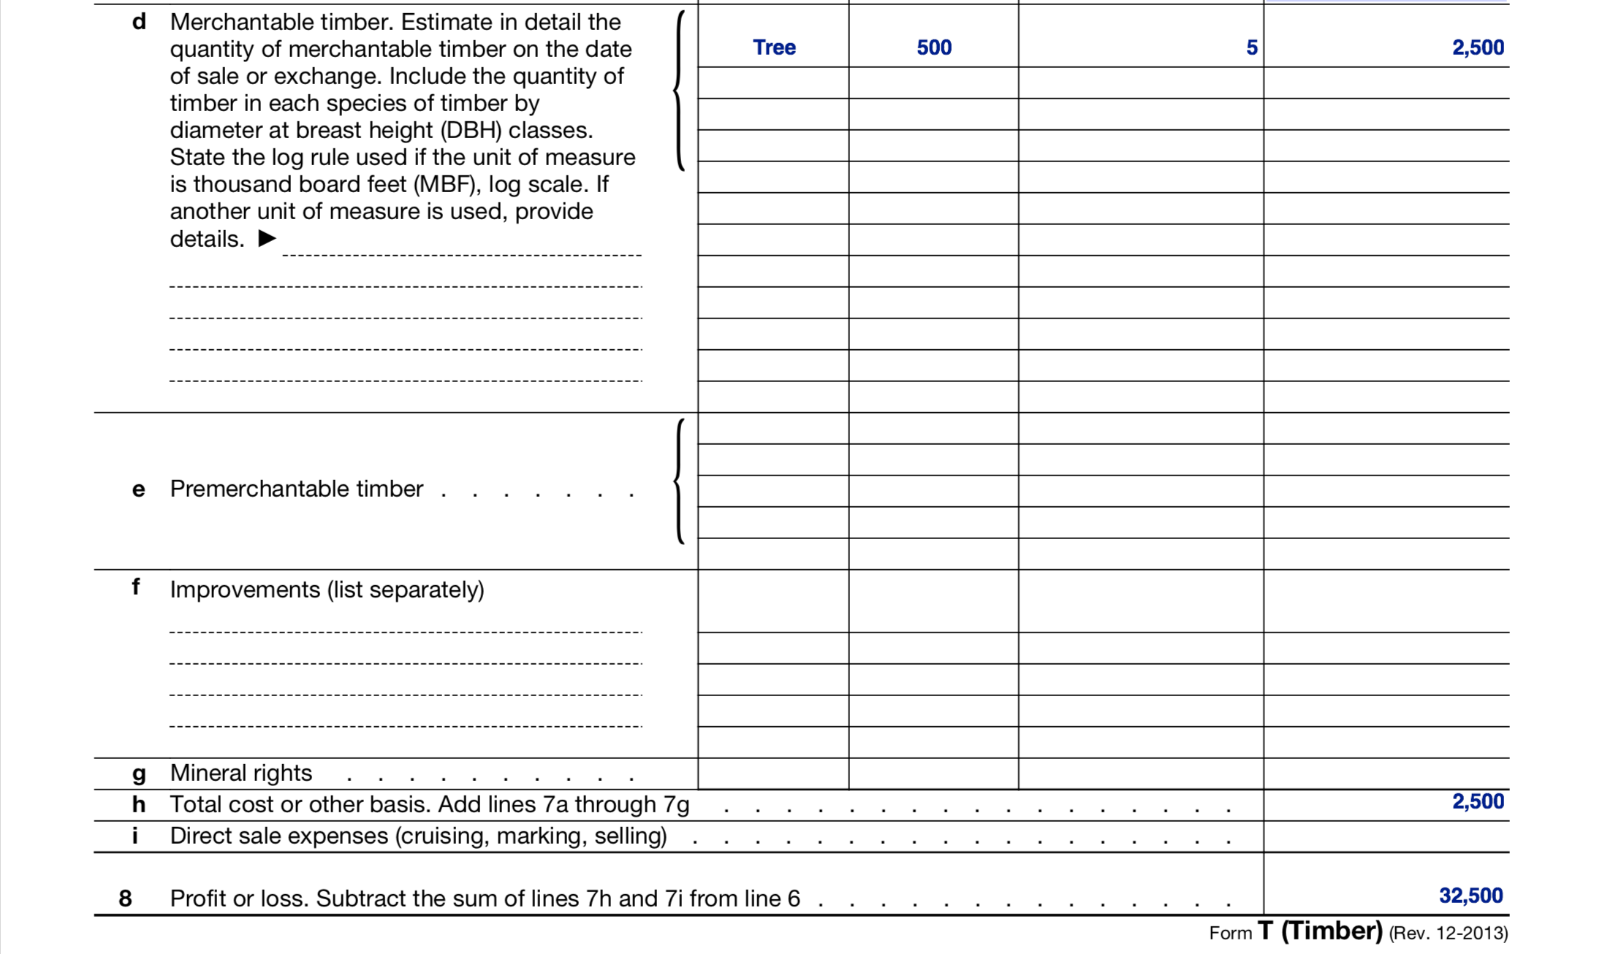
Form T - Continued

Slide 17
Ordinary Income
  Tree Income and Costs
    Choose and cut trees are $10/foot. He sells 500 choose and cut trees in 2018. All trees sold are 8 feet tall.
    Potted trees are $30 each. He sells 100 potted trees in 2018.
    He sells $5,000 worth of merchandise in 2018.
    His cost basis per choose and cut tree is $5.
    His cost basis per potted tree is $2.
    His cost of merchandise sold is $2,500

Slide 18
Ordinary Expenses
  Other Expenses
    He has Car & Truck expenses of $5,000 in 2018.
    He purchases Supplies totaling $2,000 in 2018.
    He purchases $1,000 of Fertilizer in 2018.
    He pays $10,000 for Labor on his farm.
    He purchases new equipment totaling $5,000 in 2018. He has no other depreciation expense from other equipment he owns.

Slide 19
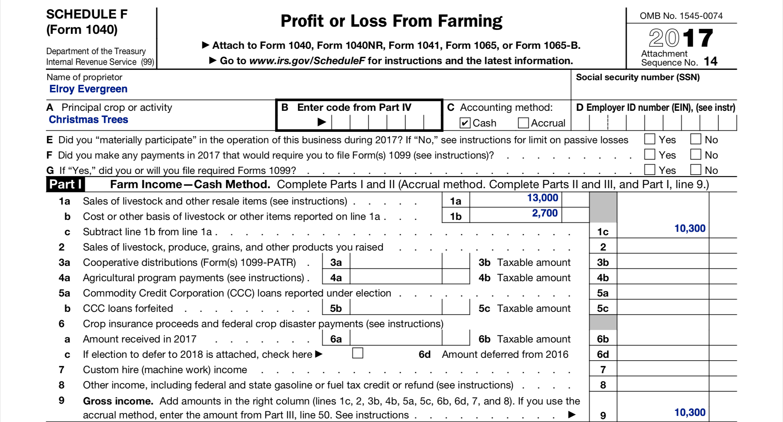
Schedule F

Slide 20
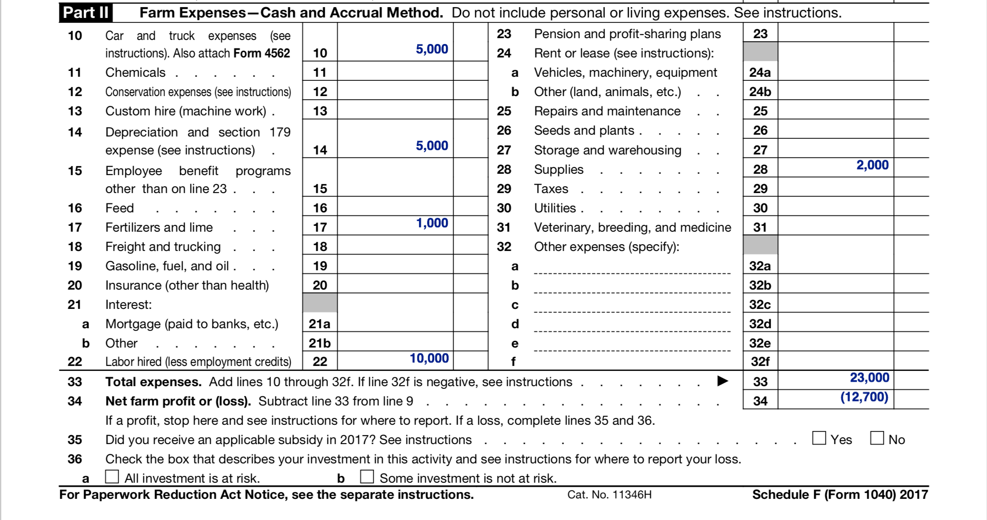
Schedule F - Continued

Slide 21
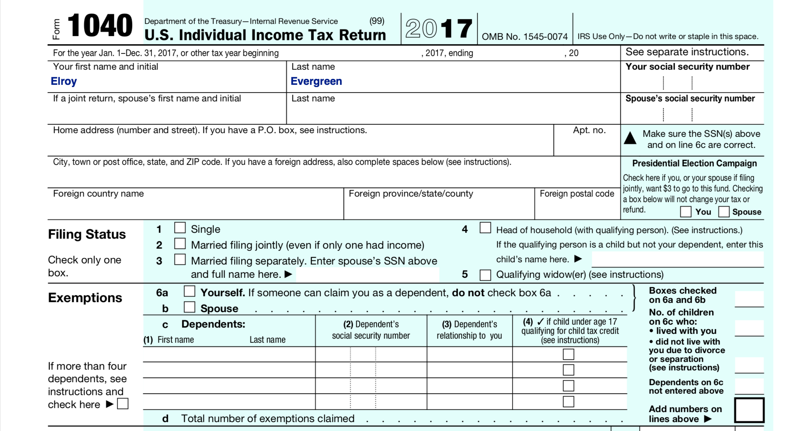
Form 1040

Slide 22
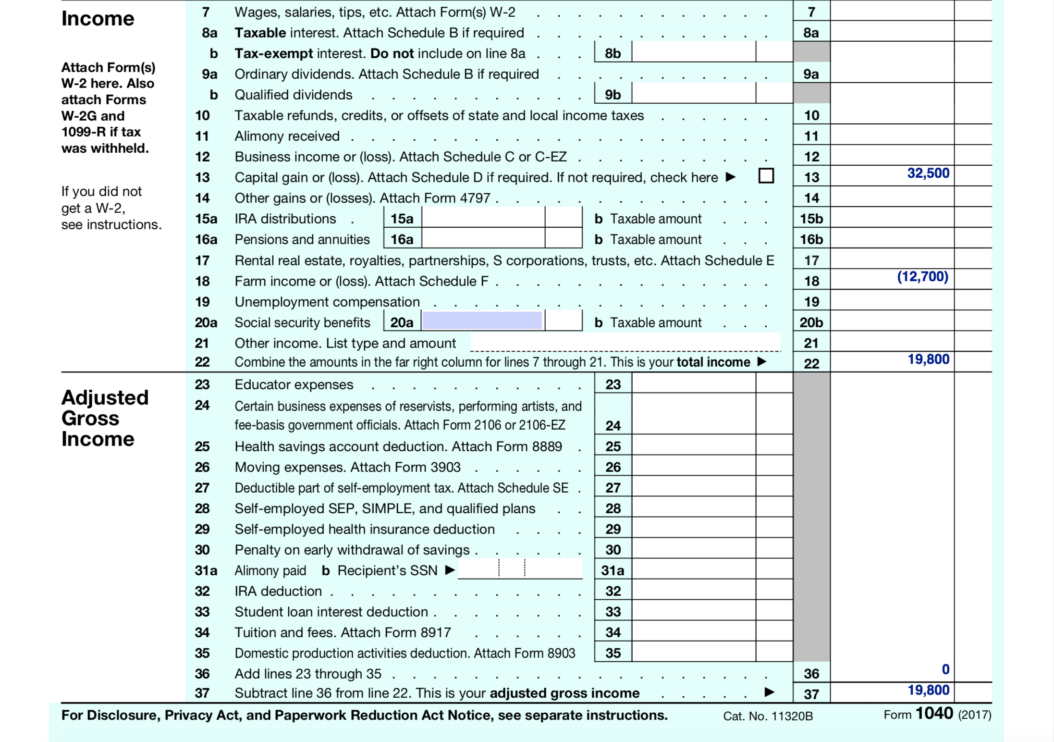
Form 1040 - Continued

Slide 23
Helpful Resources
Forest Landowners’ Guide to the Federal Income Tax
U.S. Forest Service Taxation Resources
National Timber Tax Website
Internal Revenue Code §631
IRS Form T & Instructions

Slide 24


Questions?
Andrew Bosserman
419-343-7630
andrew.j.bosserman@gmail.com

